Slide 1

3D audio
Alena Tesařová
Notes:
Hello and welcome to my presentation about 3D audio. My name is Alena Tesařová.

Slide 2
What is 3D audio?
Effect that manipulates the sound
Turns stereo songs into a multidimensional audio experience, adding space, clarity, and depth
Produced by stereo speakers, surrounded-sound speakers, speaker-arrays or headphone
Realistic
Developed in 19th century – theatrophone
Used in virtual reality, video-games
Notes:
Fisrtly, I would like to start what the 3D audio is.
So it is an effect that manipulates the sound to immerse the listener into a movie or into a song
It turns stereo songs into a multidimensional audio experience, adding space, clarity, and depth.
Most frequently, it is produced by stereo speakers, surrounded-sound speakers, speaker-arrays or headphones so it often involves to place them in three-dimensional space, including behind, above or below the listener.
Basicaly, we want to surround the listener to reach the best effect. 3D audio recreates the sounds to much more natural way so it‘s closer to what we might hear in real life. It lets us hear the same car horn as if someone was actually beeping nearby.
It was developed in 19th century when Theatrophone was invented. It is a telephonic system of transmission that involved setting up pairs of microphones that were put in front of a stage. However, the sound quality was poor.
Now it is very popular mainly because of a virtual reality thats wants to make the audio as realistic as possible and it s also widely used in video games

Slide 3
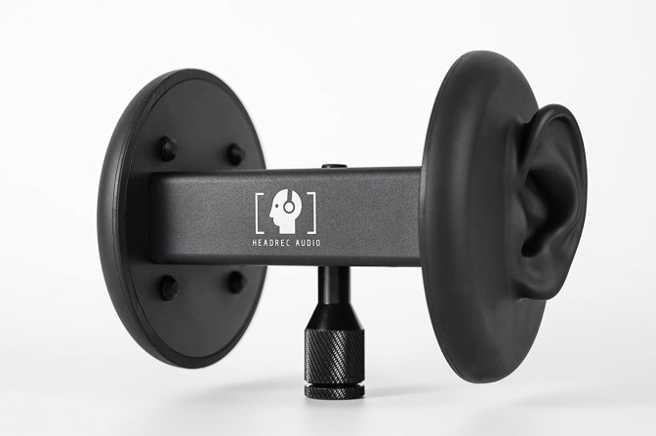
How does it work?
If the sound comes from left –> we hear it first in left ear
Mechanism varies between individuals (different head and ears) –> HRTF
Binaural recording
Intended for headphones
Notes:
So how does it work?
Simply, it makes us hear the sound as if it was happening around us, and not coming out of a set of speakers.
If a sound comes from the left, we will hear it louder in our left ear and a second ear will reach the sound a second later.
But it s not that easy. What is also involed is the size, shape of the head, ears, ear canal, density of the head and so on. It all influences the frequency of the sound before it reaches the inner ear. This mechanism is individual, as everybody has a different head and ear shape. That‘s why Head-related transfer function (HRTF) describes how a given wave input is filtered before the sound reaches the machinery of the eardrum in inner ear.
Now, it s clear that recording 3D audio needs special devices to reach this effect. One of the method is Binaural recording that uses 2 microphones that are mounted in a dummy head having ear-shaped mold as it is shown in the Picture. Binaural recording is intended for using headphones and will not translate properly over normal stereo speakers but the effect is stunning.

Slide 4
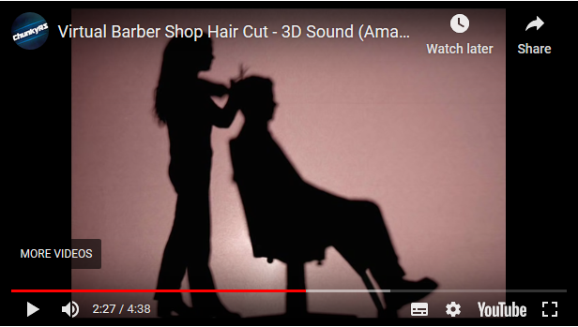
Example of 3D audio
Virtual barber shop
Notes:
Lets look at one example to better understand the 3D audio. It s a Youtube video that provides us the feeling to be physicaly in a Barber Shop. Let‘s hear just a few seconds of it but don‘t forget to use the headphones to get a full experience.
He really made us to feel that the bag was around our head.

Slide 5
Slowly but surely, binaural is becoming a linchpin in virtual reality development
Notes:
In the end I would like to say that despite the potencial od 3D audio in VR, it is not widespread because visual effects still take a lot of work and audio takes a back seat in production. Another problem is that HRTFs method often sounds unnatural. But it s a individual problem so reasearchers are thinking about some personalize acoustic body maps because everybody is different so Slowly but surely, binaural is becoming a more and more used in virtual reality development.
This topic is very large but I sumed up just the things that I think are the most important and interesting.

Slide 6
References
https://en.wikipedia.org/wiki/Head-related_transfer_function
https://home.bt.com/tech-gadgets/tv/home-cinema/what-is-3d-audio-11364187350860
https://en.wikipedia.org/wiki/Binaural_recording
https://en.wikipedia.org/wiki/3D_audio_effect
https://www.bbc.co.uk/blogs/researchanddevelopment/2013/03/listen-up-binaural-sound.shtml
https://en.wikipedia.org/wiki/Head-related_transfer_function

